Slide 1
Business and tourism
MONEY
Marinescu Andreea,Group 323

Slide 2
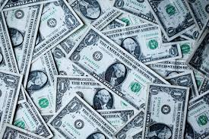
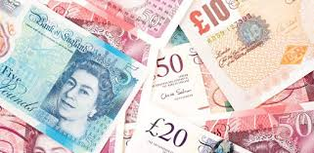
Money

Slide 3

Money is any item or verifiable record that is generally accepted as payment for goods and services and repayment of debts, such as taxes, in a particular country or socio-economic context.

Slide 4
$$$American Dollar$$$
The history of the United States Dollar refers to more than 240 years since the Continental Congress of the United States authorized the issuance of Continental Currency in 1775.On April 2, 1792, the United States Congress created the United States dollar as the country's standard unit of money. The term dollar had already been in common usage since the colonial period when it referred to eight-real coin (Spanish dollar) used by the Spanish throughout New Spain.

Slide 5

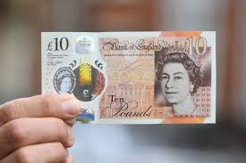
Pound sterling
The full official name pound sterling (plural: pounds sterling), is used mainly in formal contexts and also when it is necessary to distinguish the United Kingdom currency from other currencies with the same name. Otherwise the term pound is normally used. The currency name is sometimes abbreviated to just sterling, particularly in the wholesale financial markets, but not when referring to specific amounts; for example, "Payment is accepted in sterling" but never "These cost five sterling". The abbreviations "ster." and "stg." are sometimes used. The term "British pound" is sometimes used in less formal contexts, but it is not an official name of the currency.

Slide 6
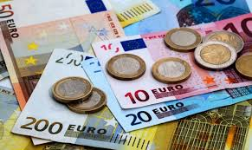
EURO
The euro is the second-largest reserve currency as well as the second-most traded currency in the world after the United States dollar.^{[12][13][14]} As of August 2018, with more than €1.2 trillion in circulation, the euro has one of the highest combined values of banknotes and coins in circulation in the world, having surpassed the U.S. dollar.

Slide 7

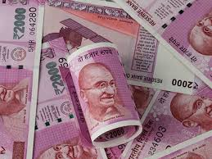
Indian rupee
he Indian rupee (sign: ₹; currency code: INR) is the official currency of India. The rupee is subdivided into 100 paise (singular: paisa), though as of 2019, coins of denomination of 1 rupee is the lowest value in use. The issuance of the currency is controlled by the Reserve Bank of India. The Reserve Bank manages currency in India and derives its role in currency management on the basis of the Reserve Bank of India Act, 1934.

Slide 8

Thank you !

